Slide 1

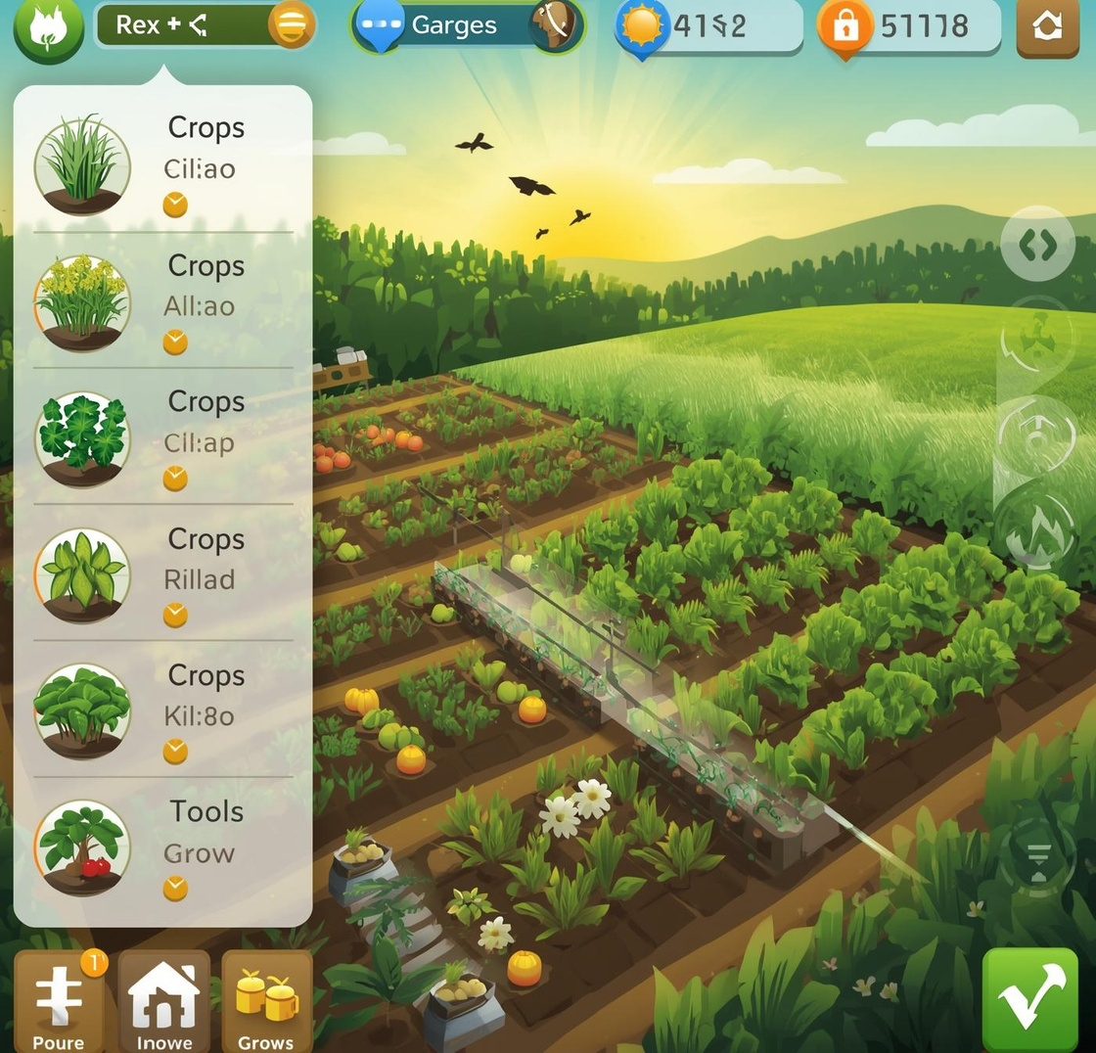

TEAM : DARK MATTER MINDS
Presents : -
KrishiPatha: Smart Sustainable Farming Game for Future Generations
Interactive ML + Game-based Learning for Sustainable Agriculture.

Slide 2

Addressing Farmers' Awareness Gap
Understanding the Problem Statement
Over 40% of water in agriculture is wasted due to inefficient irrigation.
Farmers and students lack engaging tools to understand sustainable farming practices.
Traditional awareness methods fail to create interactive learning experiences.
There is a need for climate-smart, tech-driven solutions that simplify complex agricultural decisions.

Slide 3
Proposed Solution Overview
Interactive Learning Experience
KrishiPatha utilizes gamification techniques to engage users, transforming traditional farming education into an interactive experience that encourages active participation and deeper understanding.
Impact
The game promotes awareness of sustainable farming and smart water use. It provides an interactive education tool for students and farmers. Encourages climate resilience and smart decision-making. And hence, lay foundation for AI-driven agricultural training platforms.
Data-Driven Recommendations
Personalized crop choices based on local climate conditions
Tailored livestock suggestions for optimal farming efficiency
Customized irrigation setups to conserve water resources

Slide 4




Pygame: Interactive Frontend
Pygame serves as the interactive frontend, enabling users to engage with sustainable farming simulations through a user-friendly interface, fostering an immersive learning experience for players of all ages.
FastAPI: Efficient Backend
FastAPI provides a robust, efficient backend that facilitates quick and reliable interactions between the game and the server, ensuring real-time data handling and processing for a seamless user experience.
ML Models: Intelligent Recommendations
The ML models analyze user inputs to provide intelligent recommendations on crop selection and resource management, enabling sustainable decision-making based on data-driven insights and local environmental conditions.
Technology Stack
Tools and Technologies for KrishiPatha Project

Slide 5

GAMEPLAY FLOW
Explore Stage
Decision Stage
Results
Select your farm location on a real map.
Choose crops, livestock, and irrigation type.
Get a sustainability score and performance feedback.
Simulation Stage
Quiz Section
AI Insight
System analyzes soil, temperature, and rainfall.
Watch the process and learn outcomes.
Build your knowledge by answering important farming questions.

Slide 6
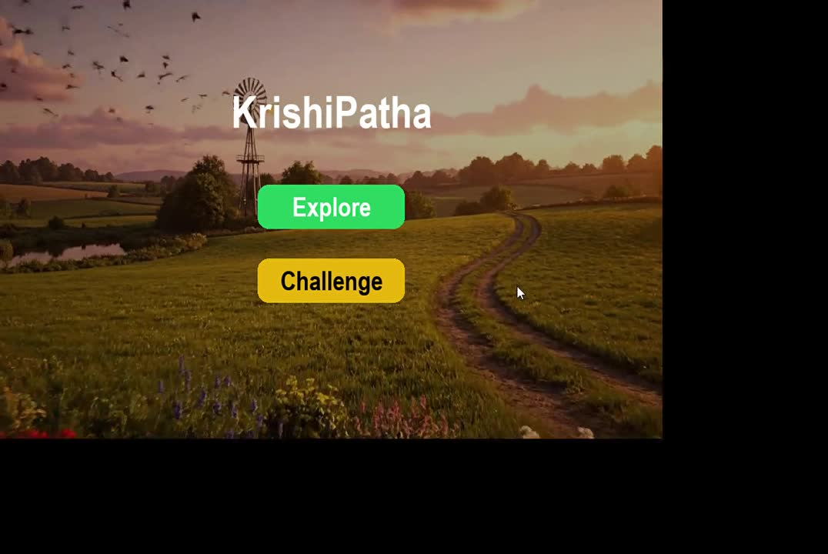
INTERACTIVE DEMONSTRATION

Slide 7
Contact Information
For any inquiries or collaboration opportunities, please reach out to our team.
Project
KrishiPatha – NASA Space Apps Challenge 2025
Email
sanskritidixit34@gmail.com
GitHub
https://github.com/Sans-kriti2004/KrishiPatha_Game

